Slide 1
Big Trout: Where to Find Them, (maybe) How to Catch Them
Brian Nerbonne| Regional Fisheries Manager

Slide 2
Outline
Lessons from large trout habitat studies
MN DNR habitat work goals
Trout diet studies
Lessons from bioenergetics studies
Putting it all together

Slide 3
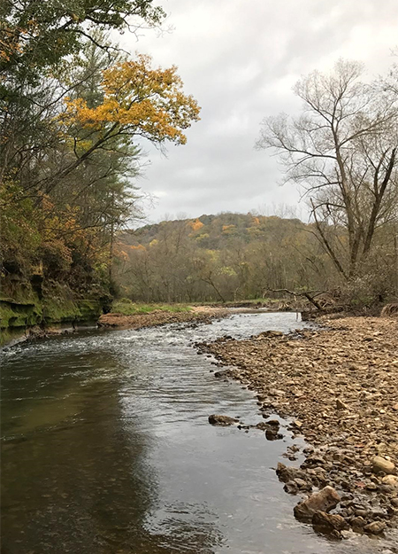
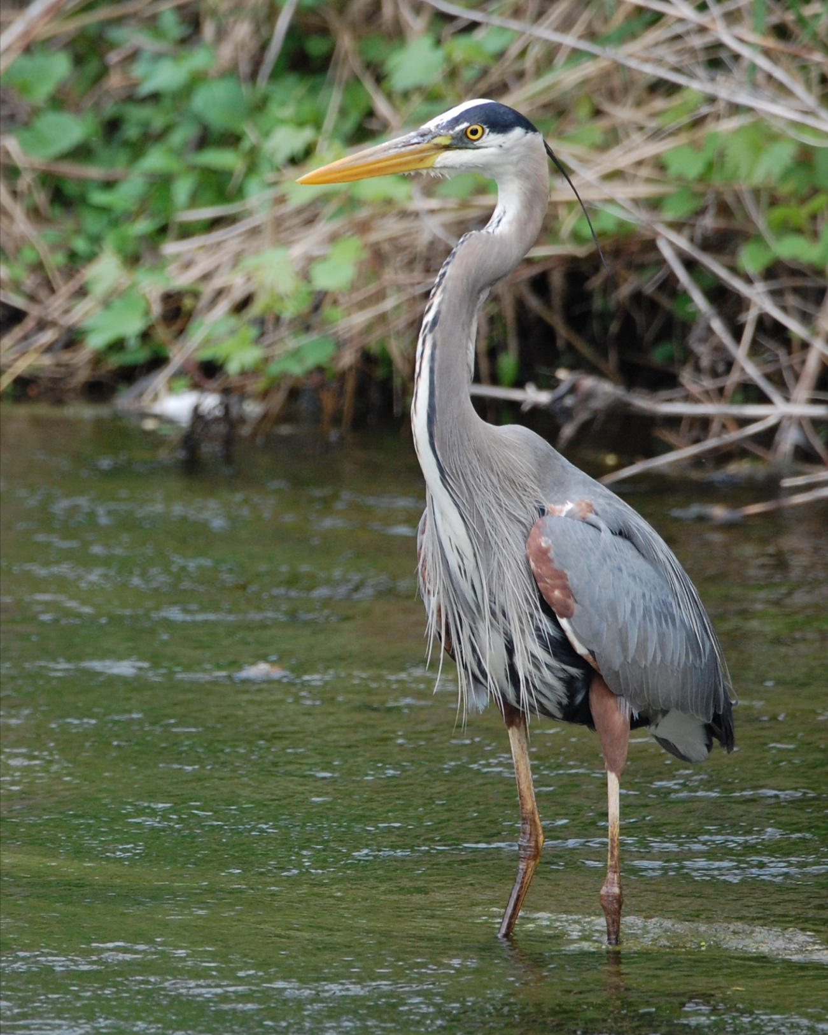
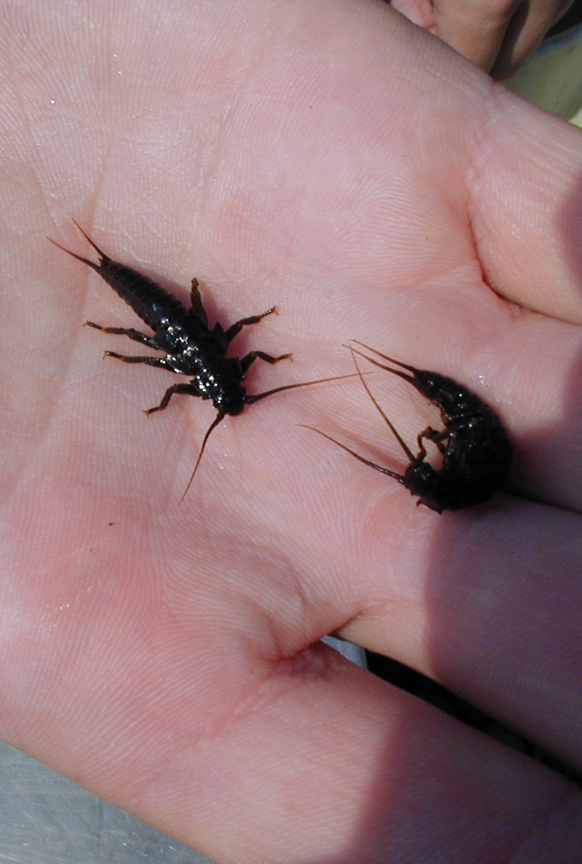
Trout Habitat Needs
Notes:
Fish have some basic needs, just like all of us. The want to be safe from getting killed, they need things to eat, and they need places to live. The places they choose to live incorporate the other two. Living in a flowing water environment, they also need to balance the energy required to find food with the energy they take in, which influences habitat choices as well. A fish could sit in the swiftly flowing riffle on the right and have lots of food go drifting by, but would spend a lot of energy doing it and be vulnerable to being eaten. They could sit in the slowest part of the pool and not spend much energy but not have many options to eat. Finding habitats that are out of the current but near enough to it to dart out and grab food items often represents the sweet spot for trout.

Slide 4
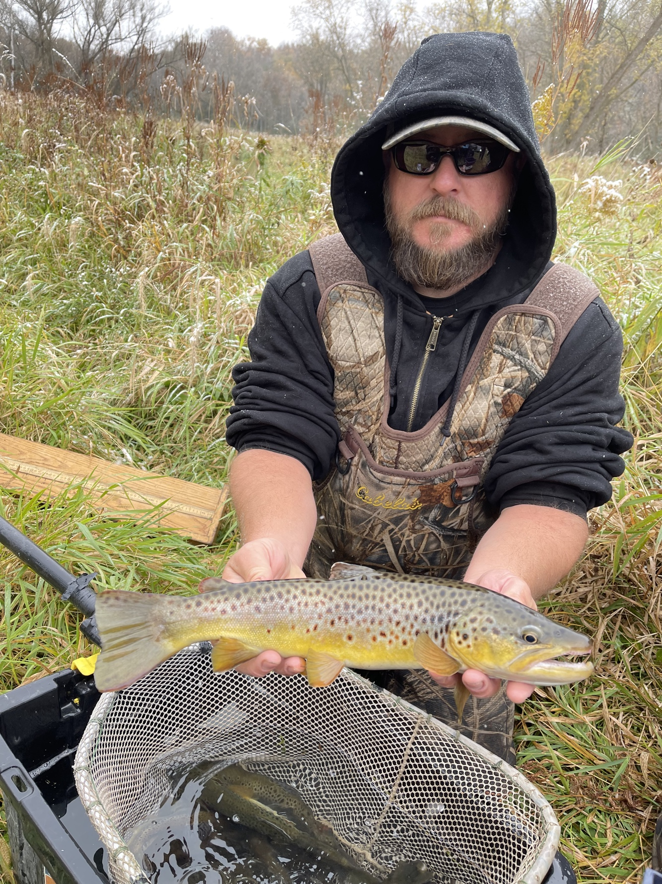
Summer Habitat
Notes:
Why focus on summer? Fish tend to stay in the same location all summer. Time where most growth occurs.

Slide 5
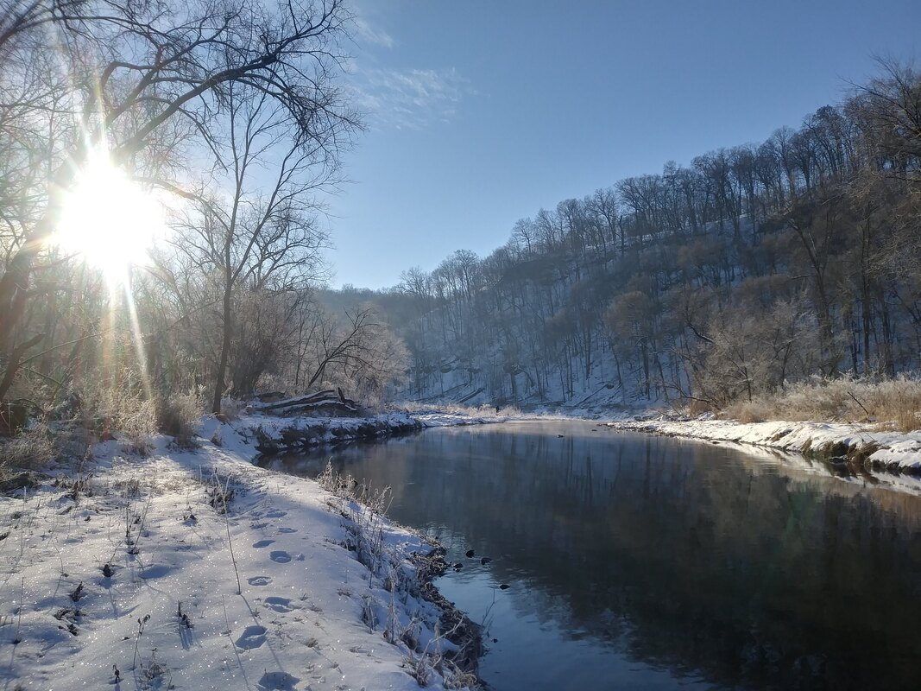
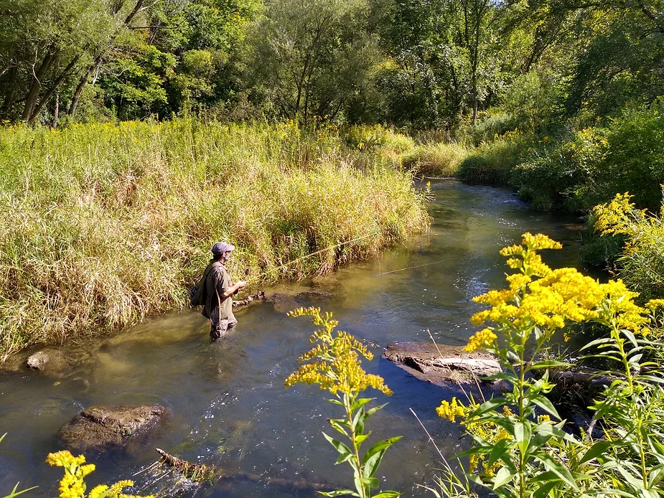
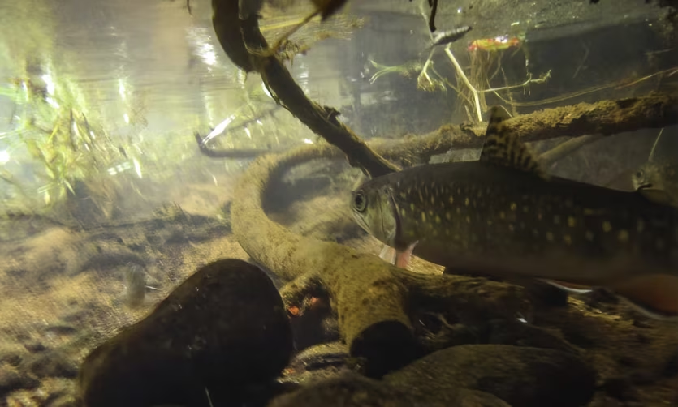
It is all about the pools!
Depth of three feet or greater
Presence of overhead cover
Instream rock
Woody debris
Pool width
Bigger streams
Notes:
Large trout habitat preferences, from Dieterman et al. 2006

Slide 6
MN DNR Habitat Work
Notes:
DNR habitat projects try to create habitat for large trout as a part of most projects, among a diversity of habitats. Narrowed streams encourage scour and deeper pools. We also leave or add large wood habitat features to provide cover. This streamside tree’s roots were left in place, but the trunk was cut off and the stump ground so that it will not catch more woody debris and potentially cause bank failure. We still also use artificial cover structures like skyhooks on occasion, but we have significantly reduced their use because they are more prone to failure than other structures that large trout will also use.

Slide 7
MN DNR Habitat Work
Notes:
Large cover rocks on the bottom pools are commonly used. Riprap along far bank has been covered by dirt and hydormulch to encourage revegetation to provide some overhanding cover and terrestrial insect production.

Slide 8
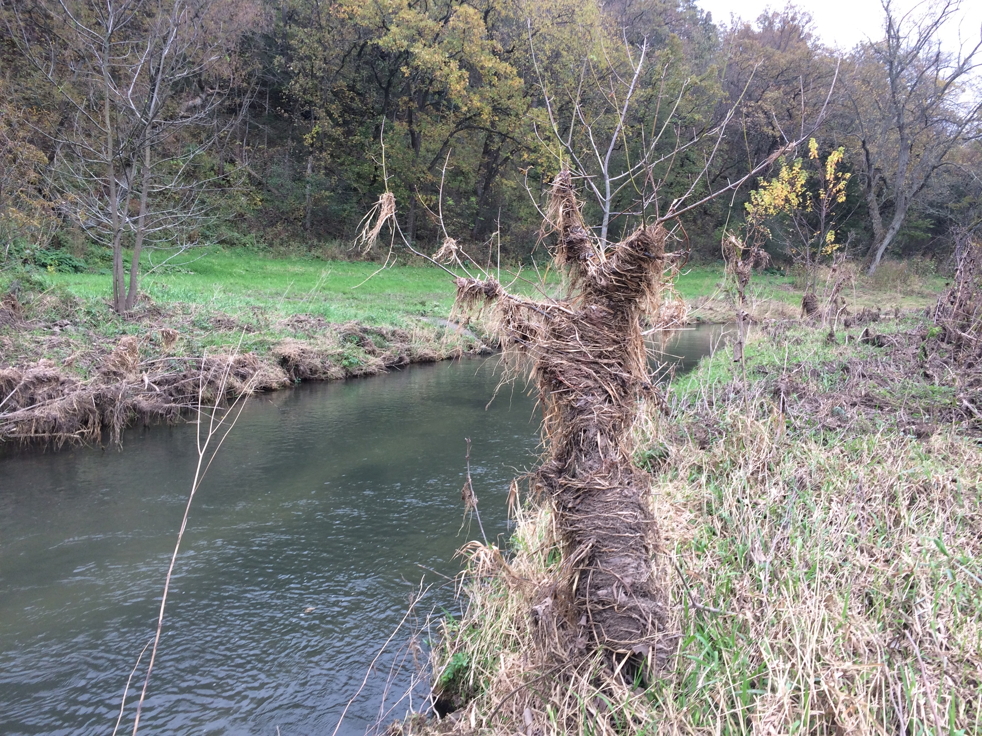
The role of floods in forming habitat
Notes:
Deep pools depend on high flows to periodically scour them out.

Slide 9
The role of floods in forming habitat
Notes:
The occasional major flood can dramatically reset habitat, such as this riffle and pool created in Whitewater State Park during the 2007 flood. Some features such as large scour pools will gradually disappear as sediment rearranges under a more normal flow regime.

Slide 10
The role of droughts in habitat
Notes:
MN DNR staff have noticed during this year’s electrofishing runs at some of our recurring stations that pools are not as deep as in past years. This probably reflects some filling of pools and a lack of scour due to drought years in the 2022 and 2023.

Slide 11
Trout biology
Notes:
Let’s shift gears for a few minutes and talk about trout biology some more, and how that relates to where large trout are found.

Slide 12
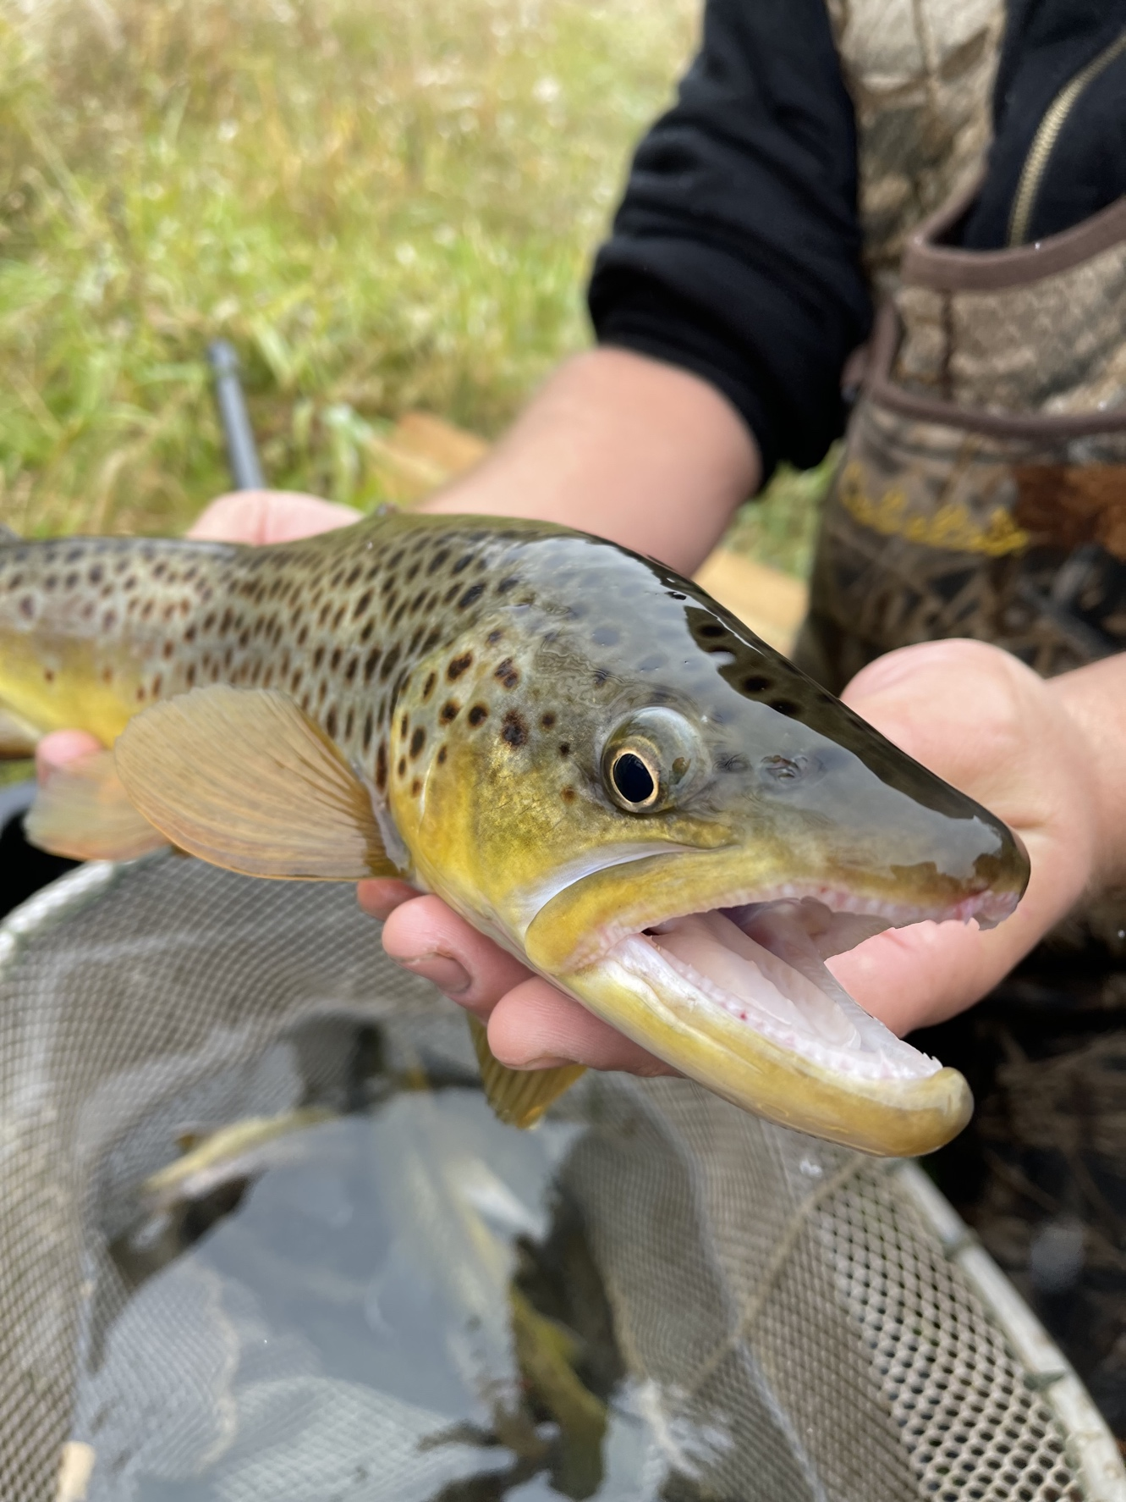
Trout biology
Notes:
Brown tour exhibit what is called an ontogentic shift, meaning they change their habits during development. They change both the habitats they utilize and the foods they consume as they get older. Aquatic invertebrates are always important, but for older trout terrestrial insects and other fish become more important because they can get far more energy in one large meal than in many small ones.

Slide 13
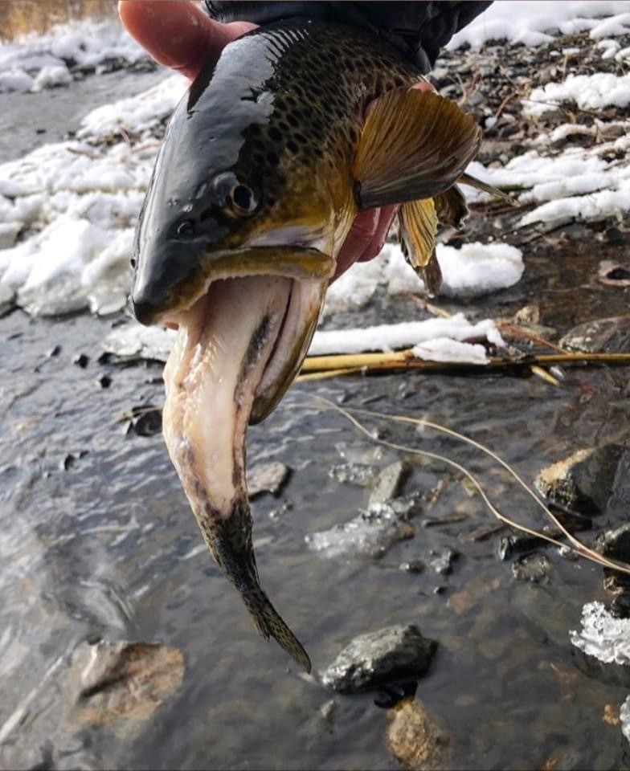
Trout biology
Notes:
Older trout also eat larger prey items for the same reasons. Larger trout are also able to occupy the prime habitat in a pool by chasing away smaller competitors, meaning they get the first choice prey items available.

Slide 14
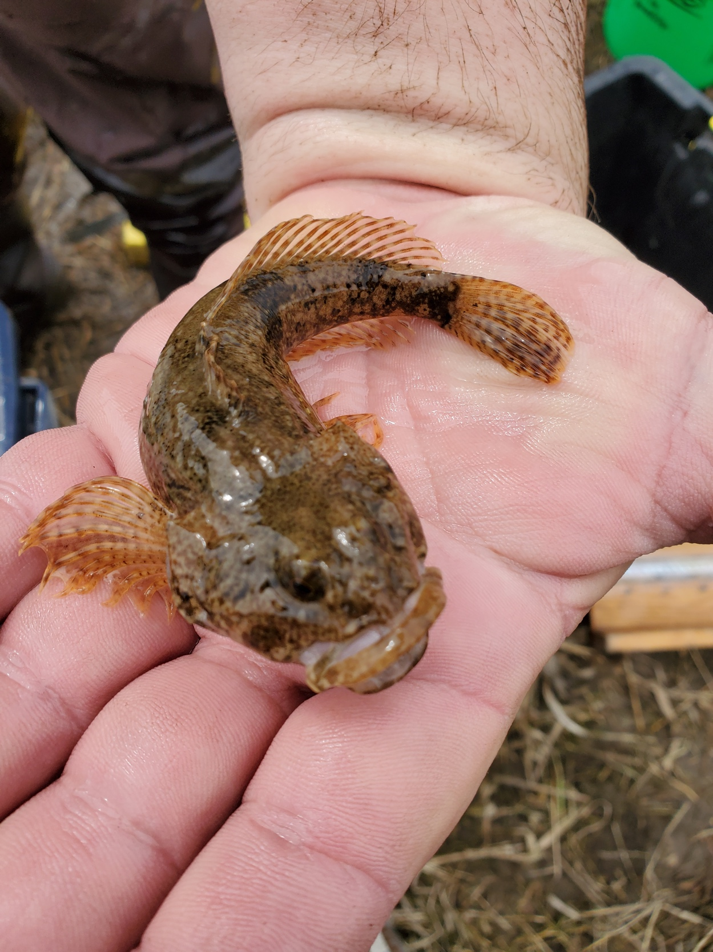
Trout biology
Notes:
Looking at the stomach contents of trout, you’ll often see bigger fish coughing up other fish and large terrestrial organisms. Trout streams can often be relatively simple fish communities, with trout often one of the only species present. In those systems, other trout can sometimes be the only option. MN DNR has been working ot reintroduce sculpins to suitable streams where they can serve as an alternative prey item for large trout. However, the streams where other fish are most abundant are the ones where a diverse fish community is found, and those tend to be streams where water temperatures are not as cold. More on that later.

Slide 15
Sculpin Reintroductions
2003-2005
Lake City Area:
Hay Creek
Trout Brook (Goodhue Co.)
Burfriends Trib./Rock Creek
Klaire Creek
Gilbert Creek
Sugar Loaf Creek
Lanesboro Area:
Latsch Creek
Pickwick Creek
Little Pickwick Creek
2022-2023
Lake City Area:
Bullard Creek
Trout Brook (Miesville)
Spring Creek
Long Creek
Lanesboro Area:
Swede Bottom Creek
Girl Scout Camp Creek
Vesta Creek
Gribben Creek

Slide 16
Trout Bioenergetics
Notes:
Bioenergetics looks at how much energy fish consume and use on basic life processes, and how much is left for growth and reproduction. Trout are cold blooded organisms whose metabolism is controlled by environmental temperatures. Laboratory studies have looked at trout growth under different temperatures, and for brown trout that is around 13-14 degrees C (55-57 degrees F).

Slide 17
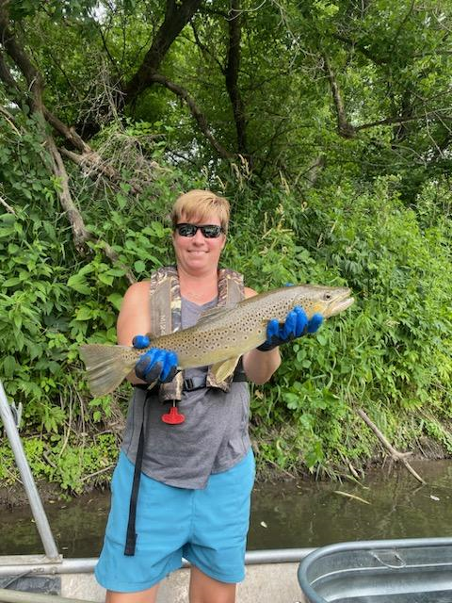
Trout Bioenergetics
Notes:
However, that optimal growth temperature depends on what the trout are eating. In this study, trout were fed either invertebrates (bottom solid line) or other fish (solid top line). You can see that trout grew much faster at all temperatures on a diet of fish, and that the optimal temperature for growth has higher, about 17 degrees C (63 F). The sweet spot for maximizing energy gain is higher because the increase in energy consumed outweighs the extra energy they expend at warmer temps. Activity level is higher at warmer temps, so they eat more prey items to overcome the higher amount of energy used.

Slide 18
Trout Bioenergetics
Notes:
MN DNR did some bioenergetics work on a number of streams. Streams with fast growth rates (line with square points) tended to be warmer in summer and colder in winter than slow growth streams (line with triangle points). Note that the fastest growing streams are closer to the laboratory optimal temperatures in summer than the slow growing ones.

Slide 19
Trout Bioenergetics
Notes:
Here’s the list of streams they studied. Slow growing sites on the top, fast growing sites on the bottom. They measured several other potential variables, but the only differences that stand out are that the faster growing streams tend to be warmer and the slower growing ones tend to be colder. The other difference I see is that the faster growing streams have more habitat for 1-2 year old trout than the slowest growing ones.

Slide 20
The Role of Harvest
Notes:
What about harvest? Here’s a shameless inclusion of my now 20 year old son with his first trout. You can probably guess from the setting that they did not go back in the stream. They were also delicious! MN DNR has attempted to use special regulations as a means to grow large trout. That includes some minimum size limits, so slot limits and some catch and release only streams. We really haven’t seen much difference in those streams from those with statewide regulations. Why? It might in part be that not many people harvest trout anymore, even when they have the opportunity. I can also say that large trout are pretty rare, even in our best streams. That makes it tough to move the needle noticeably. Finally, I think that habitat, both water temperature and the physical conditions in the stream, are probably more important than harvest in determining where large trout are found. People sometimes ask if harvesting some small to medium-sized trout is helpful or harmful to growning large trout. My take is that for a stream with good densities of trout, harvest will certainly not hurt the large trout potential of that stream. I can’t say with confidence it well help, but it won’t hurt. For streams where trout densities are low, or when it comes to the harvest of large trout themselves, I think harvest can hurt the abundance of large trout. I trust that most folks in the room know the difference between those types of streams and can safely decide where it is just fine to take some trout home to eat if they choose. I also think we may have gone a little too far in our catch and release ethic to the point where there is a stigma around harvesting trout. I think there’s room in our many of trout streams for more anglers to harvest a few trout without causing any harm.

Slide 21
Putting it all together
Bigger is better
Bigger streams
3 ft. deep or greater pools
More cover
Bigger lures
Quality over quantity
Non-classic trout waters
Notes:
Here’s my take home messages from the talk. Large trout tend to be found in our bigger streams that often are a little warmer and have a more diverse fish community. They are found in the deeper pool that also have other cover elements. Although large trout also eat aquatic insects, especially in a hatch of a larger species, they also like to eat fish and terrestrial prey. Visit that streamer box once in awhile if you want to target big fish! Finally, visit some of our non-classic trout waters and give them a try. Streams like Bear Creek or the South Branch of the Root hold some big trout, but you might also catch a bonus smallmouth bass! Fishing in the vicinity of the mouths of other trout streams on the Root can be productive, as can fishing the lower reaches of tributary streams where fish can move in and out of the bigger water. Hopefully this talk about big fish has given you some things to dream about this winter, or maybe even inspired you to go out and fish this winter!

Slide 22
Thank You!
Brian Nerbonne
Brian.nerbonne@state.mn.us
Photo credits to TCTU, Hiawatha TU, Iowa TU, and Scientific Anglers
Notes:
Thanks for the invite. Time for questions!

